Slide 1
Introduction to Physical Computing: Week 2
Julia Makivic

Slide 2
Office hours:
Thursday: 12pm - 4pm
Friday: 12pm - 4pm
*This week office hours only on Friday
Github: https://github.com/jmakivic/cci-pcomp-fall2019

Slide 3
What is physical computing?
Physical computing involves creating computational systems that respond to human and/or environmental inputs.
These inputs can be used to affect the behavior of software or hardware such as motors, lighting and other electro-mechanical devices.
Physical computing provides a means of interacting with a computational system that extends beyond standard inputs like mouses, keyboards and touch screens. It provides an alternative platform for examining how humans can relate to digital systems.

Slide 4
Physical Computing in Real Life
Affordances and Material Interaction Design
Speculative Design/Design Fiction

Slide 5
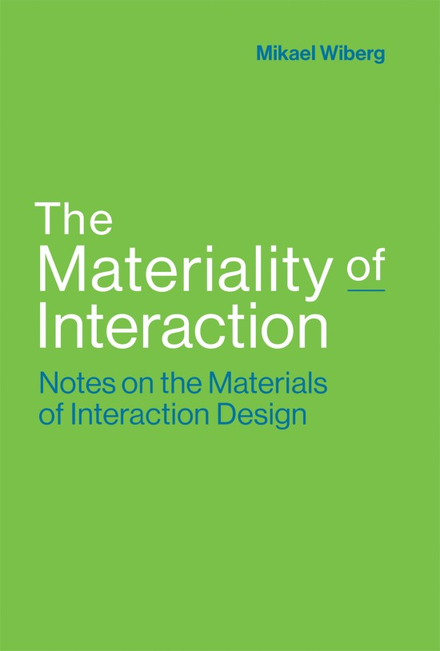
The Materiality of Interaction: Notes on the Materials of Interaction Design
By Mikael Wiberg

Slide 6
Material Interaction Design
Material-centered design approach to interaction design as a fundamental design method for working across digital, physical, and even “immaterial” materials in interaction design projects
What are some physical materials?
Digital materials?
What about “immaterial” materials?
Notes:
Wordy definition - what do you think this means? What is a digital material? What counts as physical? What even is an “immaterial” material?

Slide 7
Material Interaction Design cont . . .
Is this a digital material or a physical material?
Circuit board
Electricity
Binary code

Slide 8
What about “Immaterial” Materials?
First, a detour!

Slide 9

Notes:
Can you tell me what this is? How do you use it? Why do you use it like that? What properties of this object ensure that you use it like that?

Slide 10


Slide 11
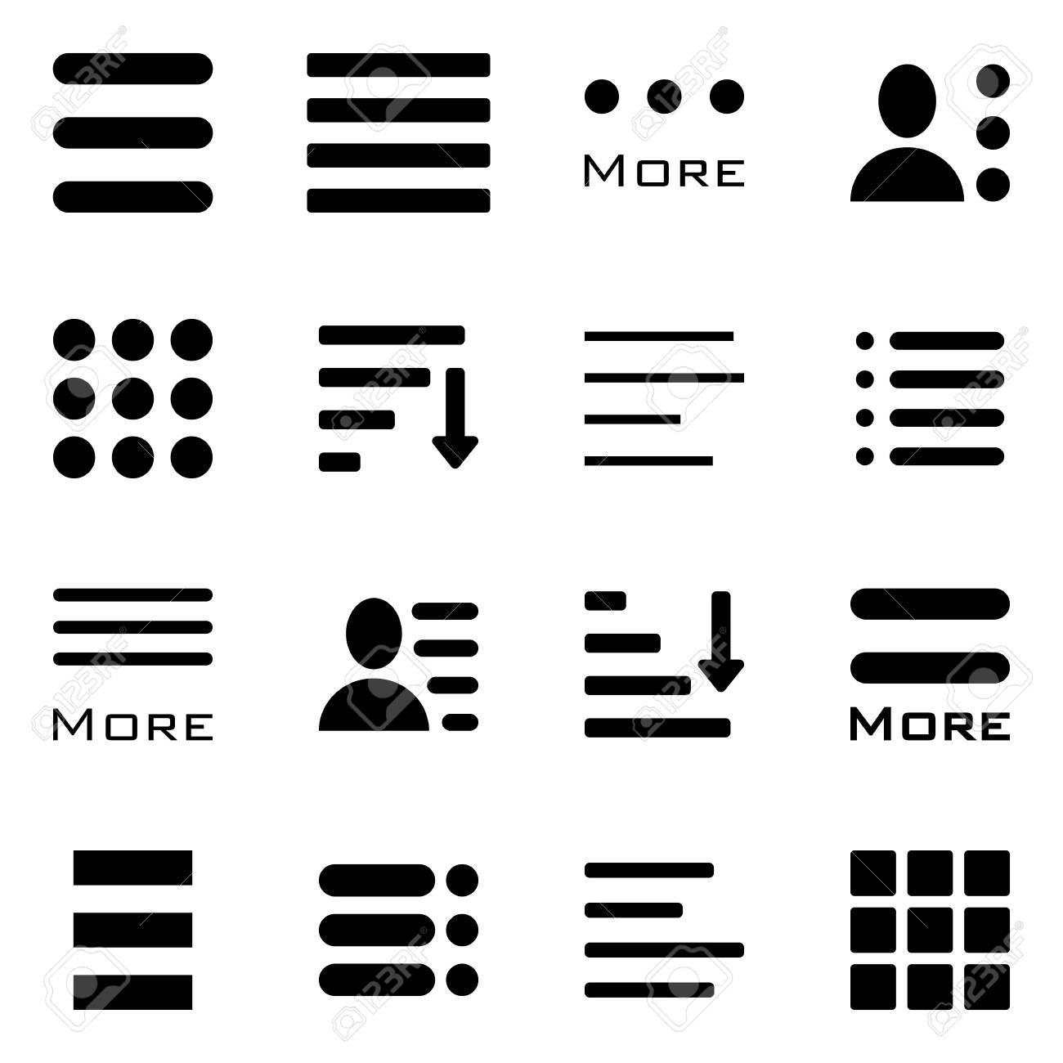

Slide 12
Affordance
Definition: a use or purpose that a thing can have, that people notice as part of the way they see or experience it
In design, perceived affordance is important — that is, our implicit understanding of how to interact with an object.
Notes:
Going through these examples, I’ve noticed we all brought our understanding of how these items should function. The designers of these items even implemented this understanding into the material decisions behind these items. Therefore, these assumptions affected the material qualities of these objects

Slide 13
But what about “immaterial” materials?
“Immaterial” materials are largely comprised of the perceived affordances of the material and formal qualities of the object
User’s default assumptions
Collective understanding of iconography
Cultural understanding of colors and symbols
Perceived functionality of object’s formal properties
Notes:
“Immaterial” materials are

Slide 14
“Immaterial” materials cont . . .
Representations of the material world in a machine
“Trash” icon on desktop
“Save” icon on desktop
Cars for drivers near you on uber
Can you think of any other representations?
Notes:
These are another kind of affordance. How do you represent the material world in a virtual interface?

Slide 15
Need to have understanding of material properties in order to design for material interaction
Need to be aware of user assumptions and cultural significance of material choices
Little separation between physical and digital materials
They affect each other
Affect the materiality of the object

Slide 16
Notes:
Using an app, to control events in the physical world. Bringing a car to you. The events in the physical world are then abstracted onto your device. Uses built-in devices on your phone such as GPS in addition to the software component. Other digital tools such as your phone number and credit card info. Design makes assumptions about how we understand maps, what we need to identify drivers and even assumptions about what we need to feel at ease when entering a stranger’s car.

Slide 17

Paro
https://www.youtube.com/watch?v=TyEY8BUuPsc
Notes:
What are some of the affordances of Paro? What are the physical materials? Digital materials? Immaterial materials? How are you supposed to interact with Paro? And how do these materials enable that interaction?

Slide 18
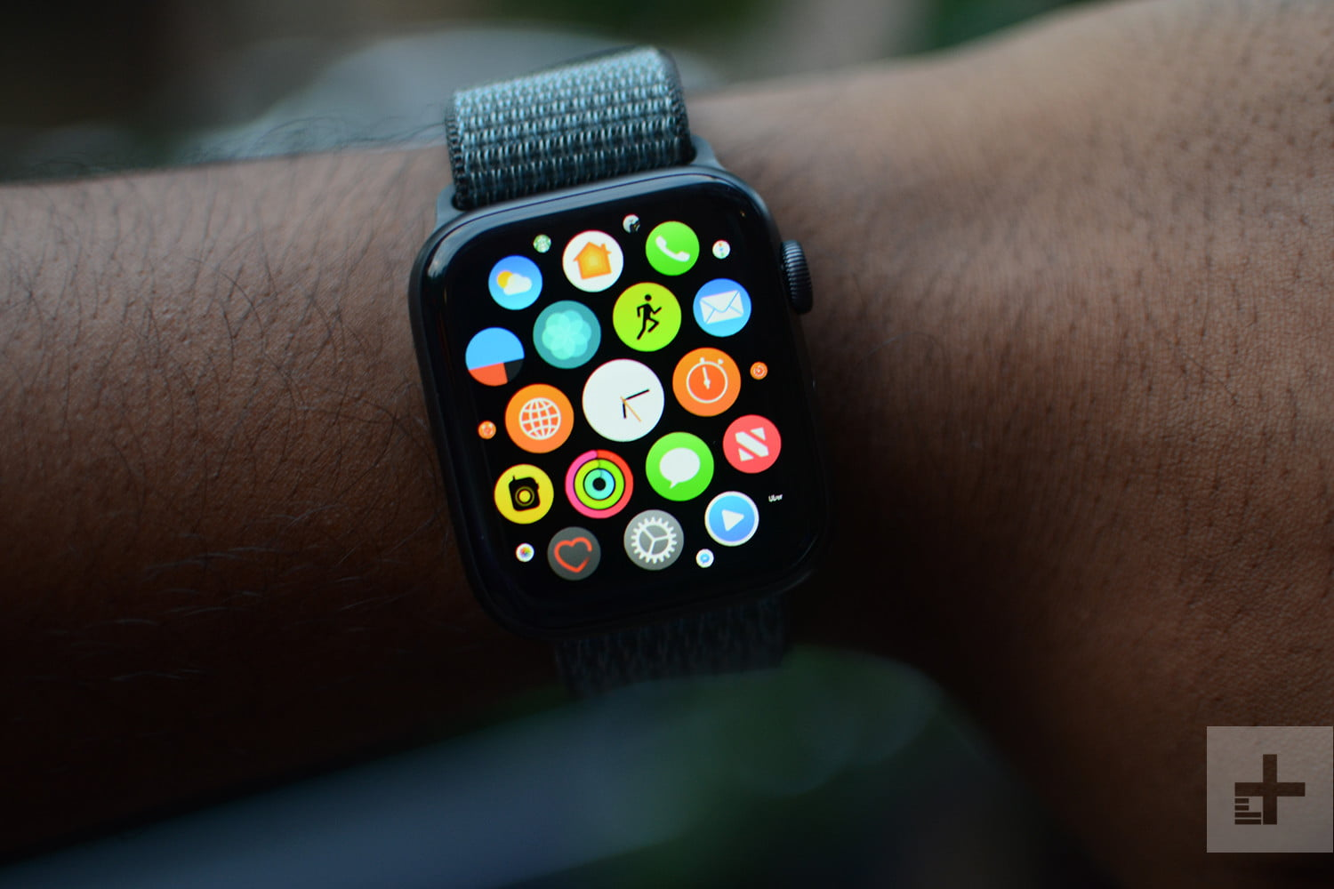
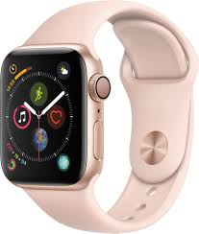
Apple Watch
Notes:
What affordances does it use? How does it borrow from a traditional watch? What are the physical, digital and immaterial materials? How does it borrow from a traditional watch and a smart phone?

Slide 19
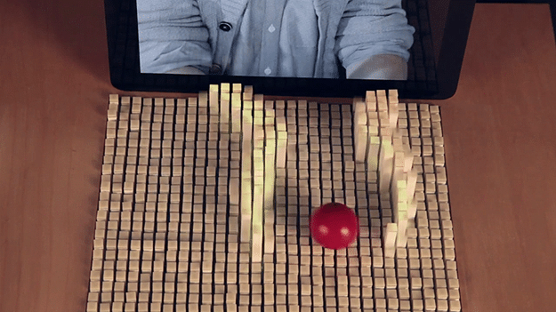
inFORM Table Display
https://tangible.media.mit.edu/project/inform/
Notes:
Physical/digital/immaterial materials? How does it allow for a certain kind of interaction? How do materials provide that kind of interaction?

Slide 20
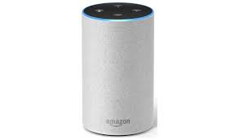
Amazon Echo
https://www.youtube.com/watch?v=VCoplDK9l_A
Notes:
How do the physical and digital properties of Amazon Echo affect one another?

Slide 21
Speculative Design and Design Fiction
Notes:
Using affordances and the material qualities of objects to understand the future, play with our assumptions and question our relationship with objects/technologies.

Slide 22
What is Speculative Design?
Speculative design is a critical design practice that comprises or is related to a series of similar practices known under the following names: critical design, design fiction, future design, anti-design, radical design, interrogative design, discursive design, adversarial design, futurescape, design art, transitional design etc.
Speculative design is a discursive practice, based on critical thinking and dialogue, which questions the practice of design (and its modernist definition). However, the speculative design approach takes the critical practice one step further, towards imagination and visions of possible scenarios.
Notes:
Uses design, quite frequently the design of objects to envision possible futures. Play with material qualities and affordances of objects to provoke questions and introduce new possibilities.

Slide 23
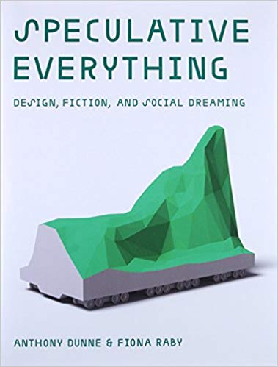
Speculative Everything by Anthony Dunne and Fiona Raby

Slide 24
James Chambers
What if objects developed survival instincts like animals?
Video

Slide 25

Sputniko!
Red Silk of Fate

Slide 26
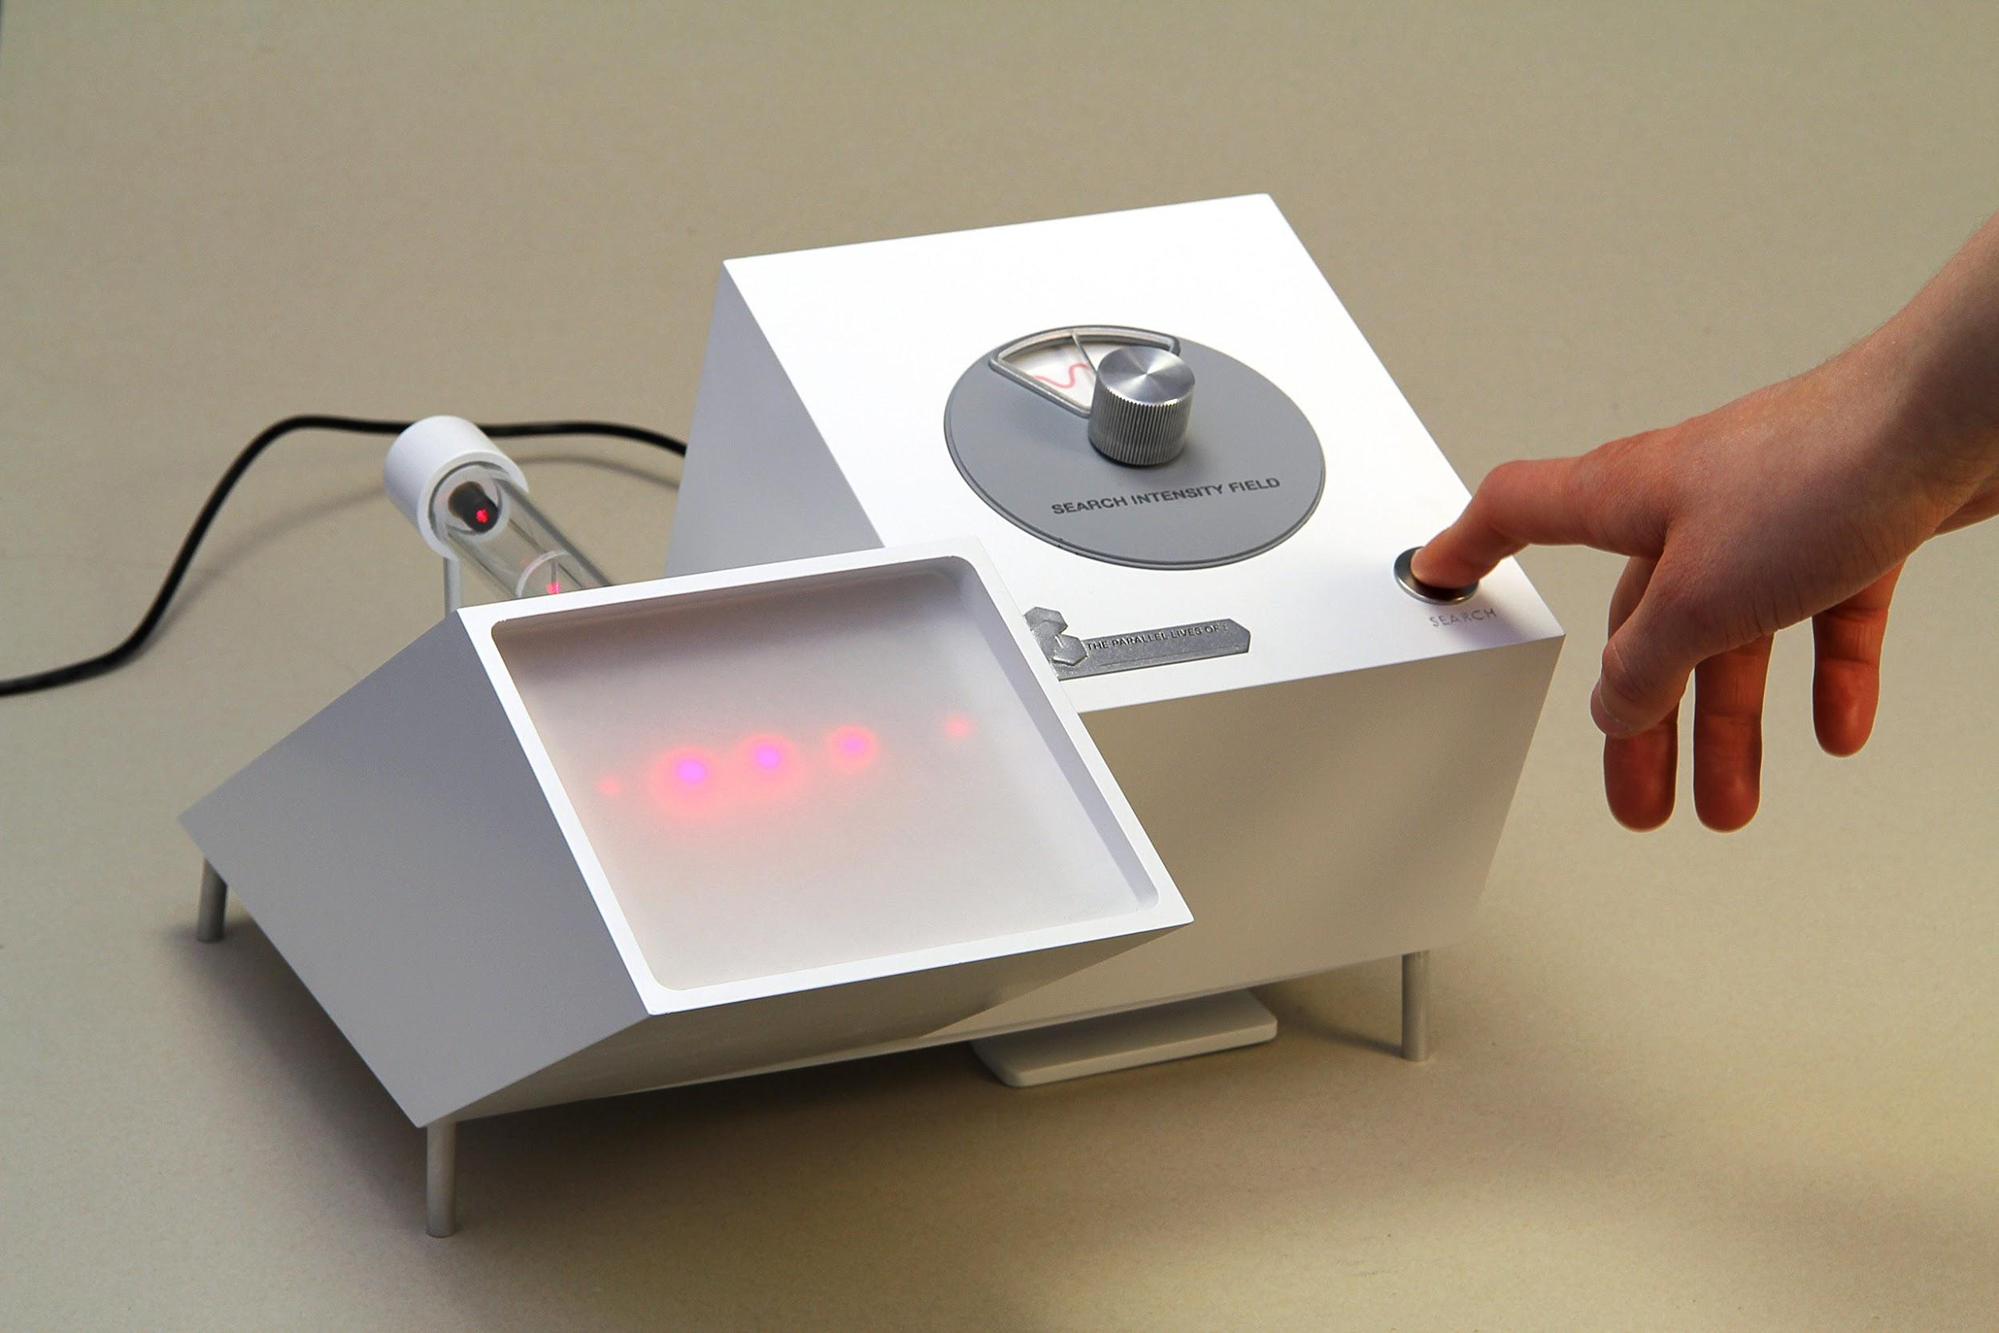
The Quantum Parallelograph by Patrick Stevenson Keating
Video

Slide 27
Dan Chen
Team Spirit Generator
End of Life Care Machine

Slide 28
==Lab==

Slide 29
Review!
What is a conductive surface?

Slide 30
What is an inductive surface?

Slide 31
What is a resistor?

Slide 32
What is a switch?

Slide 33
Last week’s homework:
Think of how you can expand on the “Spaceship Interface” exercise in the Arduino Projects book. How could you make an engaging interactive project using a few LEDS, a pushbutton and/or a tilt switch? Next week bring sketches/designs or prototypes of your ideas.

Slide 34
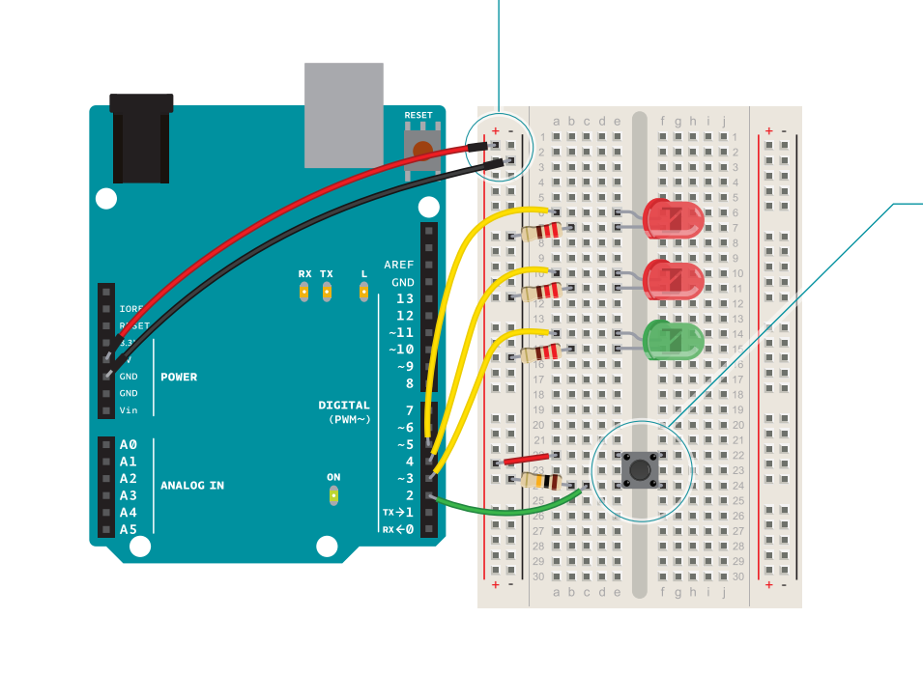
Experiment: Spaceship Interface, but with a ~~Tilt Switch~~!

Slide 35
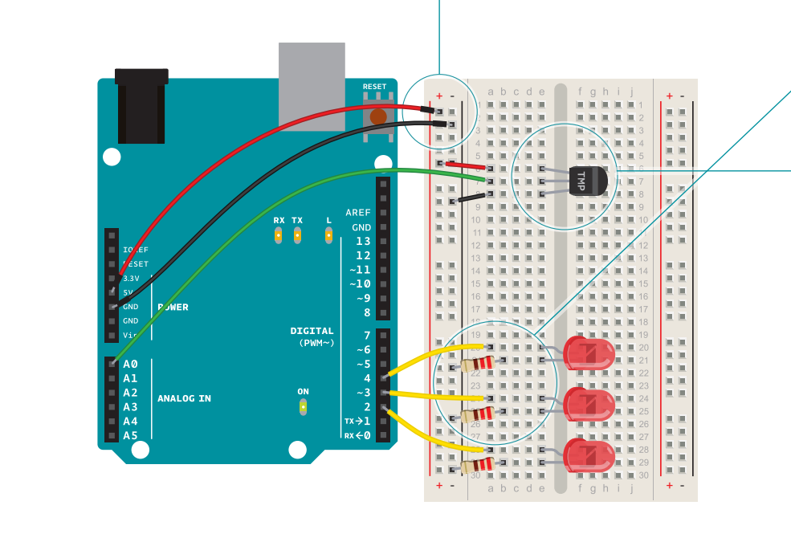
Love-O-Meter

Slide 36
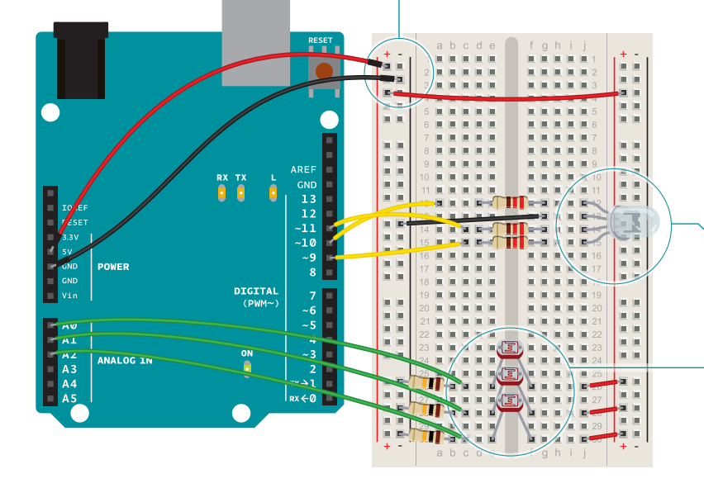
Color Mixing Lamp

Slide 37
Homework
How can you create a new speculative design object using the sensors from lab? What would the object do? What physical, digital and “immaterial” materials would it use? What affordances would its material qualities provide and what sort of interaction would they enable?
Bonus: Research a new type of sensor on your own and create a speculative object that uses it.

Slide 38
Next Class
History of haptic interfaces, technical schematics, soldering and more lab exercises.

